Slide 1
Class 4 字串、串列、迭代
游宗穎

Slide 2
字串 String

Slide 3
字串 → 一串字（元）
s = “Quan is handsome!”
s[0] → ‘Q’ # 索引從 0 開始
s[1] → ‘u’
s[2] → ‘a’
s[3] → ‘n’
s[4] → ‘ ’ # 空白也是字元
......

Slide 4
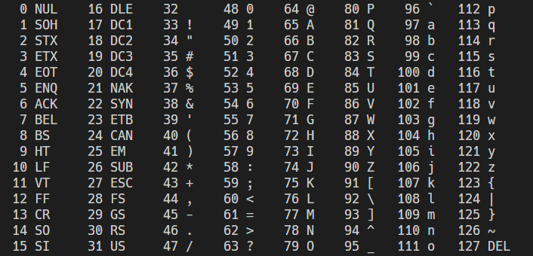
補充：ASCII 編碼

Slide 5
補充：ASCII 編碼
ord() → 回傳一個字（字元）的編碼
chr() → 回傳編碼對應到的字（字元）
ord(‘A’) → 65
ord(‘\n’) → 10
chr(48) → “0”

Slide 6
跳脫字元
\\ → 反斜線
\’ → 單引號
\” → 雙引號
\t → 定位符（Tab 鍵）
\n → 換行符
“\t\n”[1] → “\n” # 反斜線與後面的共成一個字元

Slide 7
字串切片
s[6:] → “s handsome!”
0 | 1 | 2 | 3 | 4 | 5 | 6 | 7 | 8 | 9 | 10 | 11 | 12 | 13 | 14 | 15 | 16
Q | u | a | n |  | i | s |  | h | a | n | d | s | o | m | e | !
s =

Slide 8
字串切片
s[6:] → “s handsome!”
s[:9] → “Quan is h” # 取到第 n-1 個
0 | 1 | 2 | 3 | 4 | 5 | 6 | 7 | 8 | 9 | 10 | 11 | 12 | 13 | 14 | 15 | 16
Q | u | a | n |  | i | s |  | h | a | n | d | s | o | m | e | !
s =

Slide 9
字串切片
s[6:] → “s handsome!”
s[:9] → “Quan is h” # 取到第 n-1 個
s[?] → “handsome”
0 | 1 | 2 | 3 | 4 | 5 | 6 | 7 | 8 | 9 | 10 | 11 | 12 | 13 | 14 | 15 | 16
Q | u | a | n |  | i | s |  | h | a | n | d | s | o | m | e | !
s =

Slide 10
字串切片
s[6:] → “s handsome!”
s[:9] → “Quan is h” # 取到第 n-1 個
s[8:16] → “handsome”
0 | 1 | 2 | 3 | 4 | 5 | 6 | 7 | 8 | 9 | 10 | 11 | 12 | 13 | 14 | 15 | 16
Q | u | a | n |  | i | s |  | h | a | n | d | s | o | m | e | !
s =

Slide 11
字串切片
s[6:] → “s handsome!”
s[:9] → “Quan is h” # 取到第 n-1 個
s[8:16] → “handsome”
s[-1] → “!”
0 | 1 | 2 | 3 | 4 | 5 | 6 | 7 | 8 | 9 | 10 | 11 | 12 | 13 | 14 | 15 | 16
Q | u | a | n |  | i | s |  | h | a | n | d | s | o | m | e | !
s =

Slide 12
字串切片
s[6:] → “s handsome!”
s[:9] → “Quan is h” # 取到第 n-1 個
s[8:16] → “handsome”
s[-1] → “!”
s[8:-1] → ?
0 | 1 | 2 | 3 | 4 | 5 | 6 | 7 | 8 | 9 | 10 | 11 | 12 | 13 | 14 | 15 | 16
Q | u | a | n |  | i | s |  | h | a | n | d | s | o | m | e | !
s =

Slide 13
字串切片
s[6:] → “s handsome!”
s[:9] → “Quan is h” # 取到第 n-1 個
s[8:16] → “handsome”
s[-1] → “!”
s[8:-1] → “handsome”
0 | 1 | 2 | 3 | 4 | 5 | 6 | 7 | 8 | 9 | 10 | 11 | 12 | 13 | 14 | 15 | 16
Q | u | a | n |  | i | s |  | h | a | n | d | s | o | m | e | !
s =

Slide 14
字串切片
s[6:] → “s handsome!”
s[:9] → “Quan is h” # 取到第 n-1 個
s[8:16] → “handsome”
s[-1] → “!”
s[8:-1] → “handsome”
s[::-1] → “!emosdnah si nauQ”
0 | 1 | 2 | 3 | 4 | 5 | 6 | 7 | 8 | 9 | 10 | 11 | 12 | 13 | 14 | 15 | 16
Q | u | a | n |  | i | s |  | h | a | n | d | s | o | m | e | !
s =

Slide 15
注意
s = “Quan is handsome!”
s[0] = ‘q’ → Error
s = “q” + s[1:]

Slide 16
注意
s = “Quan is handsome!”
s[0] = ‘q’ → Error
s = “q” + s[1:]

Slide 17
字串長度 len
len(str) → 回傳字串長度
s = “0123456789”
len(s) → 10

Slide 18
搜尋 find, rfind
s.find(str) → 回傳第一個 str 的位置，若找不到回傳 -1
s.rfind(str) → 同上，但到著往前搜尋
s = “happy happy”
s.find(“p”) → 2
s.find(“x”) → -1
s.rfind(“happy”) → 6

Slide 19
去頭去尾 strip
s.strip(str) → 回傳去除頭尾 strA 的字串
s = “\n\nTseng is 180cm\n”
s.strip(“\n”) → “Tseng is 180cm”
s.strip(“180”) → “\n\nTseng is 180cm\n”
s = s.strip(“ ”)

Slide 20
取代 replace
s.replace(strA, strB)
→ 回傳將 s 中所有 strA 取代成 strB 後的字串
s = “Kafuu Chino ga suki”
s.replace(“suki”, “kawaii”) → “Kafuu Chino ga kawaii”
s.replace(“ ”, “”) → “KafuuChinogasuki”
s = s.replace(“ ”, “ ”)

Slide 21
數量 count
s.count(str) → 回傳 s 中 str 的數量
s = “karakai jouzu no Takagisan mo kawaii”
s.count(“ka”) → 4

